Slide 1

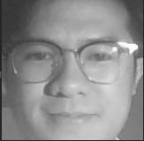
Fully connected 1 Dense (ReLU)
Fully connected 2 Dense (ReLU)
1024
1024
7
48
48
48
24
24
24
24
12
12
12
12
0.5
0.2
0.2
0.5
128
128
4608
64
64
64
64
Conv 4
Conv 5
Pooling 3
Flatten
Fully connected 3 Dense (Softmax)
Conv 2
Conv 3
Dropout 3
Dropout 4
Pooling 2
Conv 1
Dropout 2
Conv 0
Pooling 1
Dropout 1

Slide 2
Fully connected 1 Dense (ReLU)
Fully connected 2 Dense (ReLU)
Fully connected 3 Dense (ReLU)
512
256
128
7
48
48
48
24
24
24
24
12
12
12
12
6
6
6
6
3
2048
0.5
0.5
0.5
0.5
0.2
0.2
0.2
512
512
64
64
128
128
256
256
Flatten
Dropout 5
Dropout 6
Dropout 7
Fully connected 4 Dense (SoftMax)
Conv 2
Conv 5
Conv 7
Conv 1
Conv 3
Conv 4
Conv 6
Conv 0
Pooling 1
Pooling 2
Pooling 3
Pooling 4
Dropout 1
Dropout 2
Dropout 3
Dropout 4

Slide 3
Fully connected 3 Dense (ReLU)
Fully connected 2 Dense (ReLU)
Fully connected 3 Dense (ReLU)
Fully connected 1 Dense (ReLU)
Fully connected 2 Dense (ReLU)
Fully connected 1 Dense (ReLU)
512
512
256
256
128
128
7
7
48
48
24
48
24
48
48
48
24
24
24
24
12
24
12
24
12
12
12
12
6
12
6
12
6
6
6
6
6
6
3
3
2048
2048
0.5
0.5
0.5
0.5
0.5
0.5
0.5
0.2
0.5
0.2
0.2
0.2
0.2
512
512
512
256
512
256
256
64
256
64
128
64
128
64
128
128
Flatten
Flatten
Fully connected 4 Dense (SoftMax)
Dropout 5
Fully connected 4 Dense (SoftMax)
Dropout 5
Dropout 6
Dropout 6
Dropout 7
Dropout 7
Conv 7
Conv 2
Conv 7
Conv 2
Conv 5
Conv 3
Conv 5
Conv 3
Conv 6
Conv 1
Conv 6
Conv 1
Conv 4
Conv 0
Conv 4
Conv 0
Pooling 4
Pooling 3
Pooling 4
Pooling 2
Pooling 3
Pooling 1
Pooling 2
Pooling 1
Dropout 4
Dropout 3
Dropout 4
Dropout 1
Dropout 3
Dropout 1
Dropout 2
Dropout 2

Slide 4
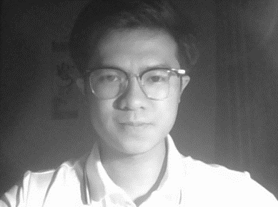
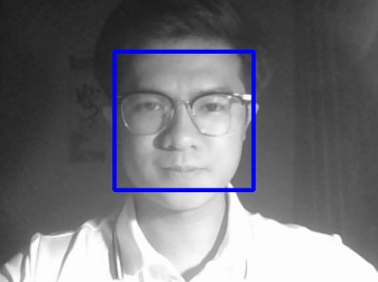
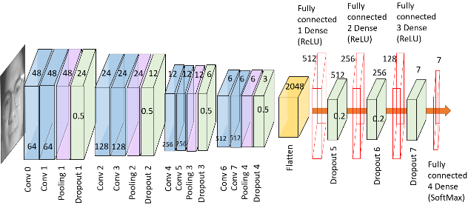
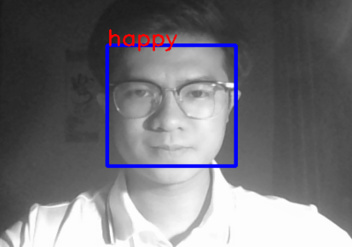
Ảnh đầu vào
Phát hiện khuôn mặt
Tiền xử lý ảnh
Nhận dạng cảm xúc
Ảnh kết quả

